Slide 1

Presenter: Chua Kai Feng

Slide 2
Agenda
Introduction
What is AnyThing & AnyWhere?
What is the goal?
Importance of e-commerce
How does it benefit businesses?
Problems e-commerce facing
Exposure
Service Base Business
Logistics

Slide 3

Introduction

Slide 4

What is AnyThing & AnyWhere?
An innovative E-commerce platform designed to assist physical retailers
Target audience: Shopping Mall Retailers
Featuring an extensive range of products from shopping destinations such as Parkway Parade, Katong I12 and more

Slide 5
What is the goal?
Revolutionise the shopping experience allowing users to shop in a single online location effortlessly.
Opening a new income and traffic stream for business owners.
Expand opportunities for a logistics partner
Consolidate delivery fees for purchases from multiple stores in the same shopping into one charge

Slide 6
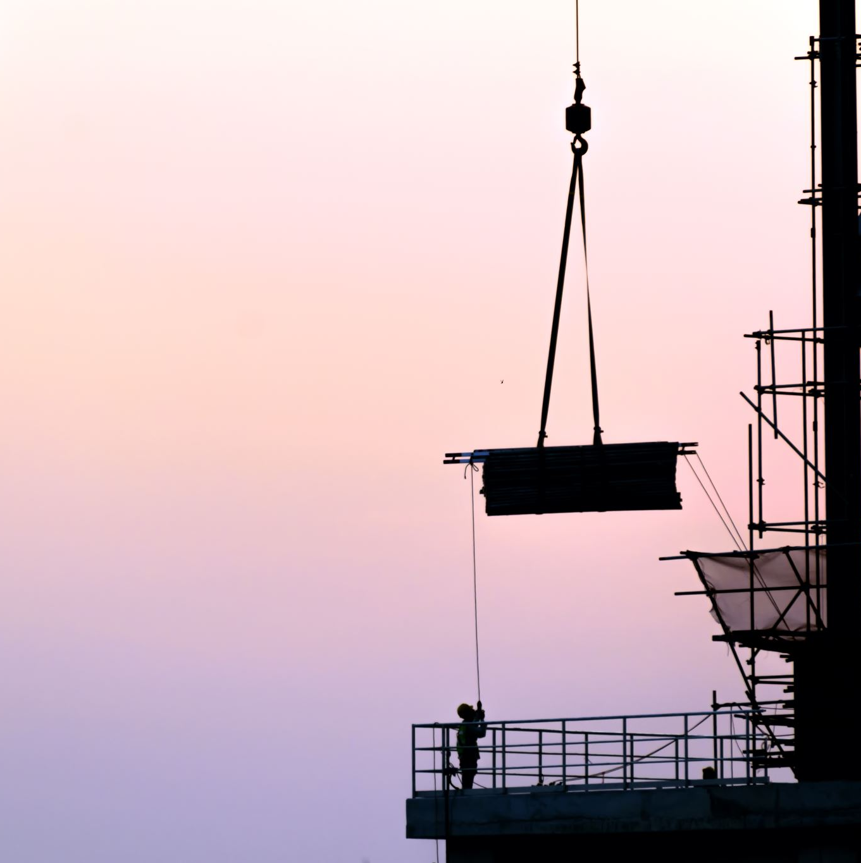
Importance of E-commerce

Slide 7
How does it benefit business?
24/7 Availability
Customer Insights
Increasing Sales Channels
Scalability
Automated Operations

Slide 8

Problems E-commerce Facing

Slide 9
Exposure
Service Base Business
Lesser known retailers have yet to incorporate into their business model
Logistics
Services providers may not be viable for e-commerce
Slow delivery time, minimum 3 days is the Standard.

Slide 10

Project Planning

Slide 11
Features
Extensive Product Catalogue
Advanced Search and Filtering
AI Chatbot Assistance
Real- Time Inventory Updates (Client)
Multiple Payment Options

Slide 12
Risk
Data Security
Logistics Matters
Site Maintenance
Coordination with Business Owners
Technical Challenges

Slide 13
Technologies Involve
Frontend | Backend (Server) | Database | UI Drafting
HTML | Node.js | MongoDB | Draw.io
CSS | Express.js
JavaScript
Bootstrap

Slide 14

Database Designing

Slide 15
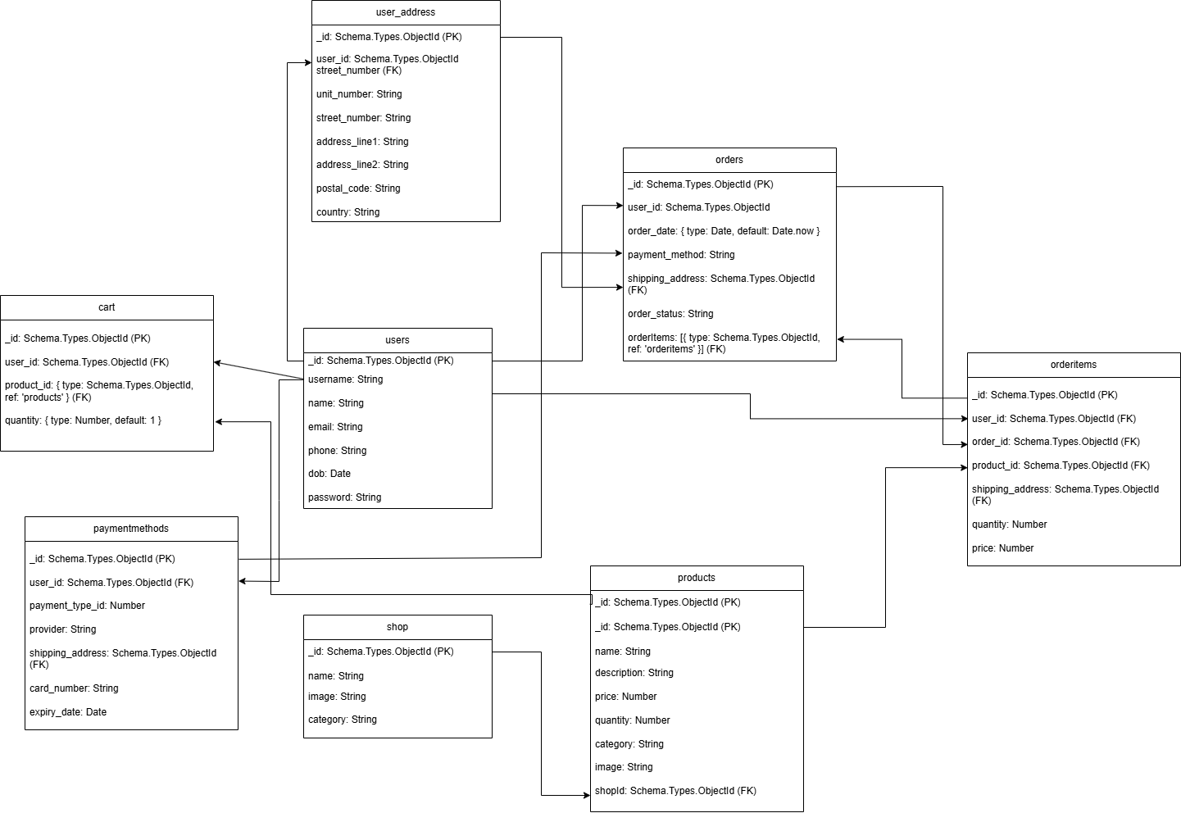
Database Design

Slide 16

UI Drafting

Slide 17
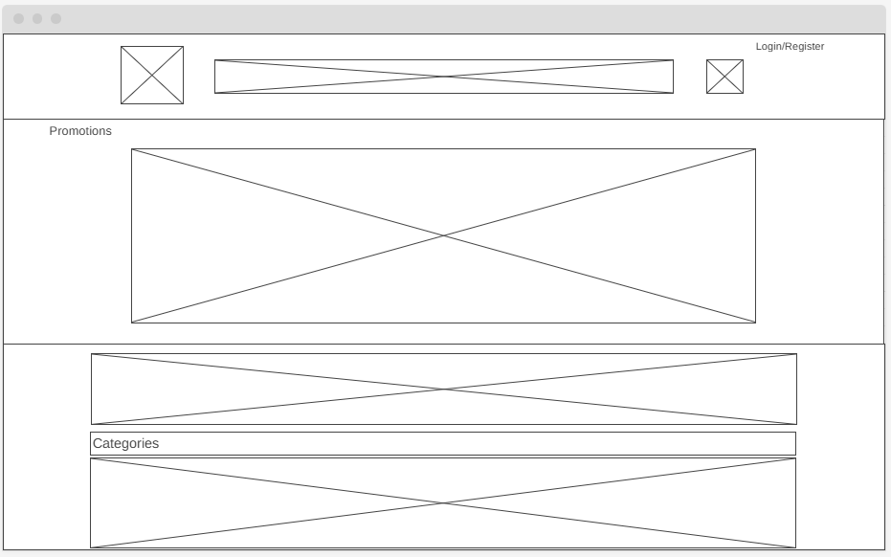
Landing Page

Slide 18





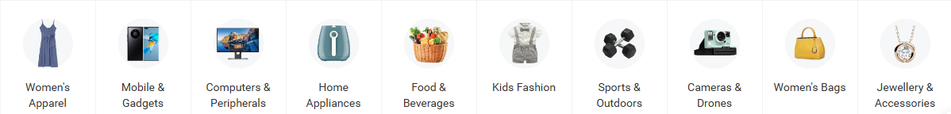
Login / Register
Promotions
https://www.google.com/url?sa=i&url=https%3A%2F%2Finvideo.io%2Fblog%2Fsales-promotion-ideas%2F&psig=AOvVaw2n-cludTkEcEgCsiQAyrCZ&ust=1717679908040000&source=images&cd=vfe&opi=89978449&ved=0CBIQjRxqFwoTCLDYkr3GxIYDFQAAAAAdAAAAABAJ
SIGN UP NOW FOR $10 Voucher On All Order!!!
Featured Stores

Slide 19
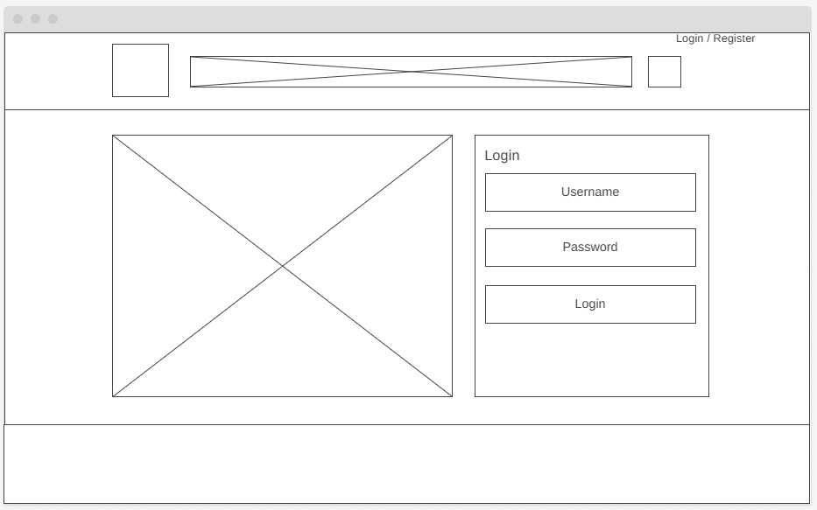
Login Page

Slide 20

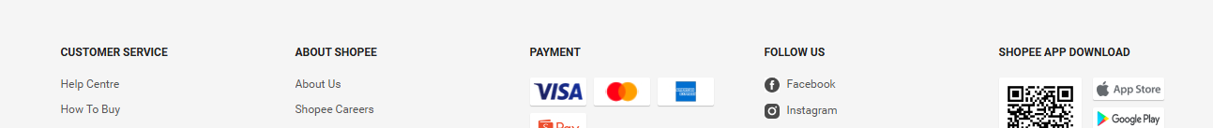
Login / Register
JOIN US! JOIN THE BLUE SIDE!
SIGN UP NOW FOR $10 Voucher On All Order!!!
Promotion ends on 31 August
LIMITED CUSTOMERS ONLY**
Login
Username
Password
LOG IN
Forget password?
New here? Sign Up Here
ABOUT US

Slide 21
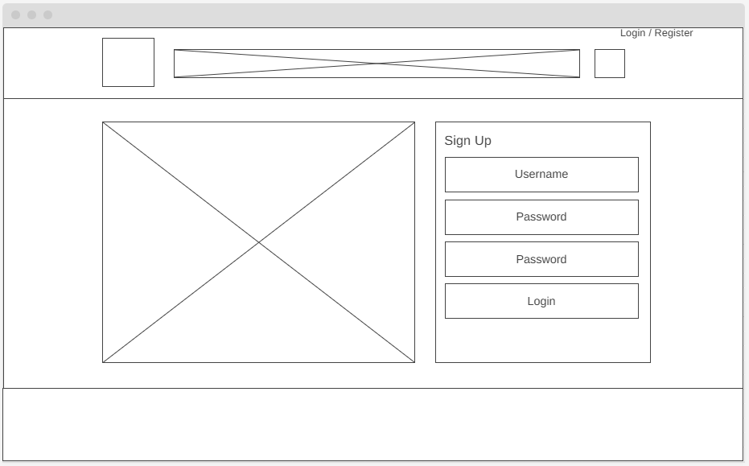
Register Page

Slide 22
Login / Register
JOIN US! JOIN THE BLUE SIDE!
SIGN UP NOW FOR $10 Voucher On All Order!!!
Promotion ends on 31 August
LIMITED CUSTOMERS ONLY**
Sign Up
Username
Password
Password
LOG IN
Existing Customer Sign Up Here
ABOUT US

Slide 23
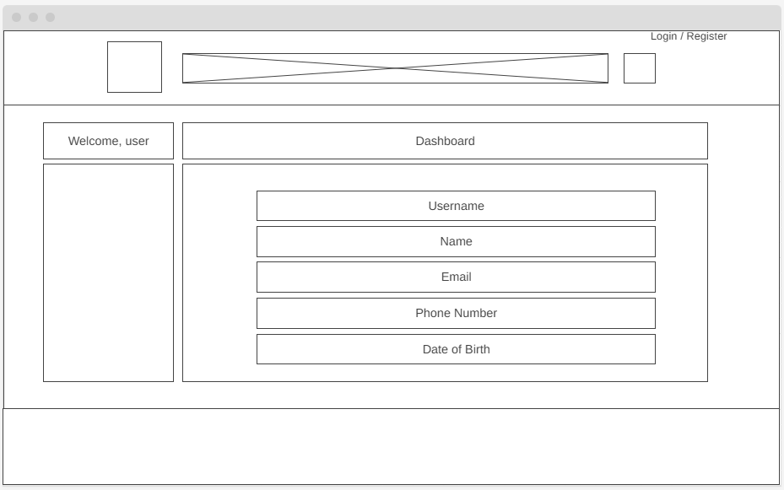
Dashboard

Slide 24
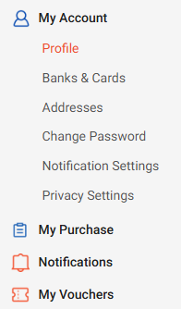
Login / Register
Welcome back, Grapes
Dashboard
Username
Name
Email
Phone Number
Date of Birth

Slide 25
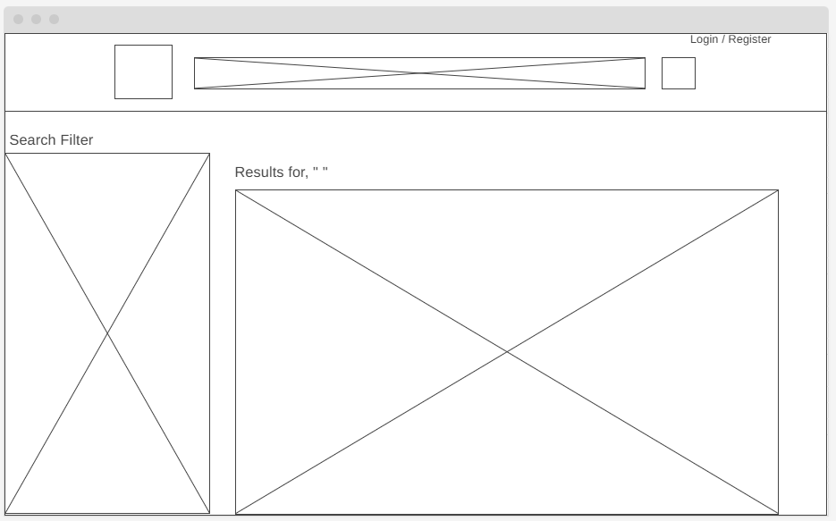
Search result

Slide 26
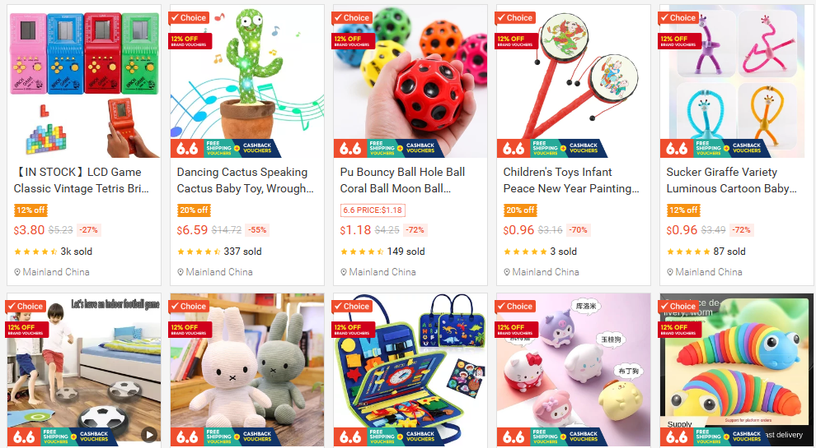
Login / Register
Toys
SEARCH FILTER
Shipping Option
Self Collection
Doorstep Delivery
Rating
⭐⭐⭐⭐⭐
⭐⭐⭐⭐
⭐⭐⭐
⭐⭐
⭐
Price Range
Results for “Toys”
Sort by: price low - high
$ MIN
$ MAX
Category
Cards
Action Figurines
Statues
Blocks

Slide 27
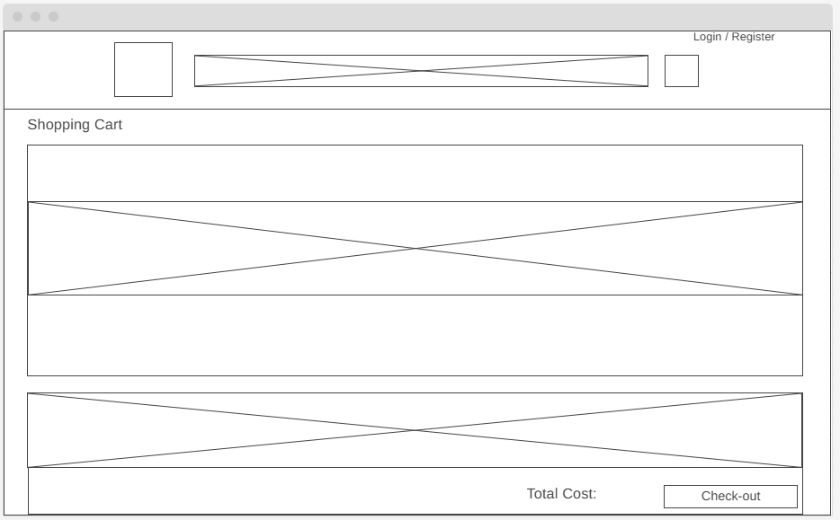
Shopping Cart

Slide 28
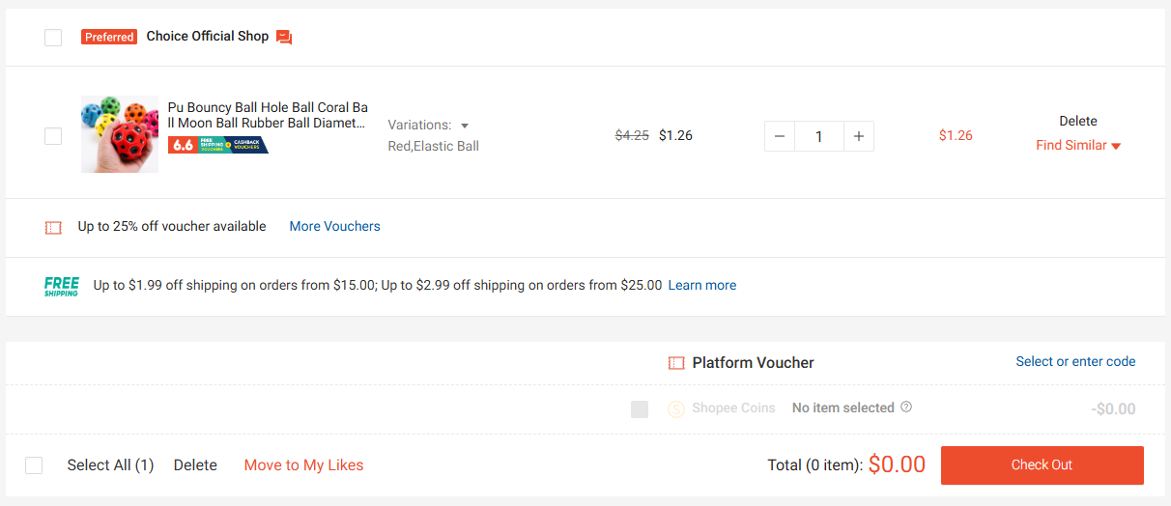
Login / Register
SHOPPING CART
Evergreen
Free shipping on orders more than $40
Check-out

Slide 29
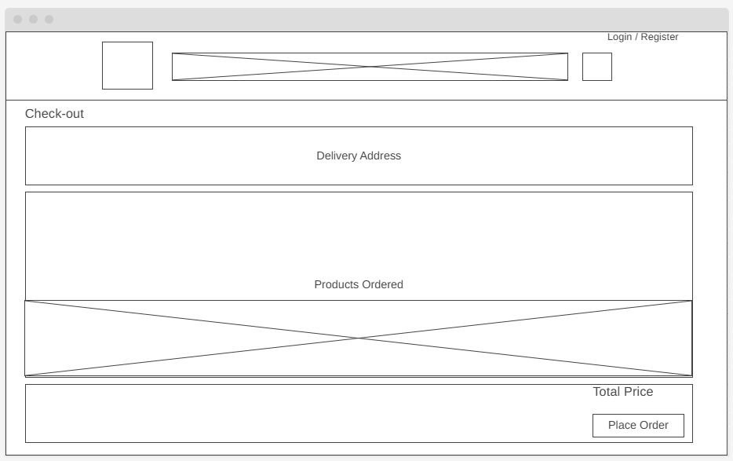
Check-out

Slide 30

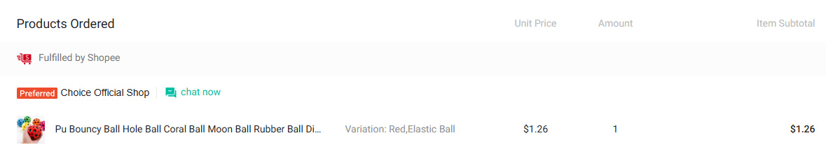
Login / Register
CHECK-OUT
Delivery Address
John, +65 89097755, 67 EAST COAST ROAD #08-33, SG 556634
Evergreen
Shipping Total: $1.99
TOTAL PRICE: $1.26
Place Order

Slide 31

Jira Timeline

Slide 32
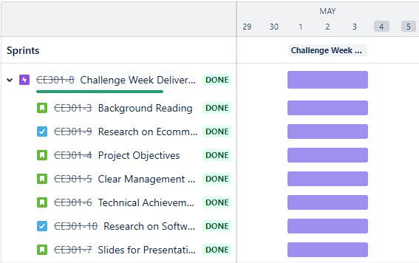
Sprint 1

Slide 33
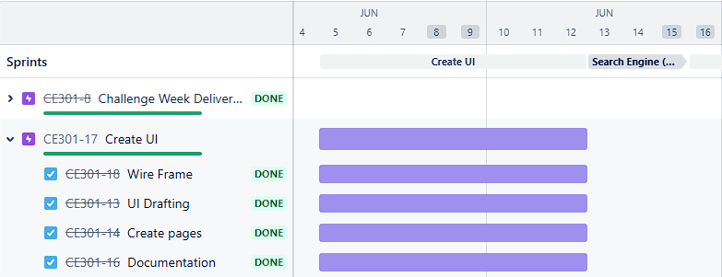
Sprint 2

Slide 34
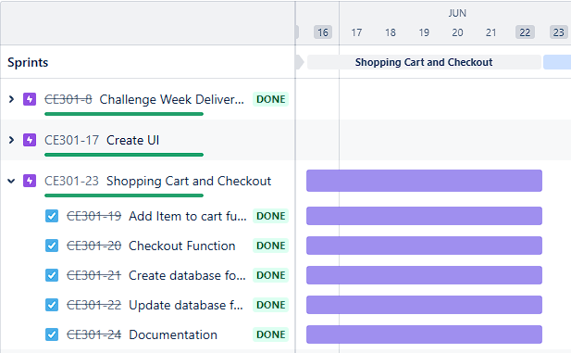
Sprint 3

Slide 35
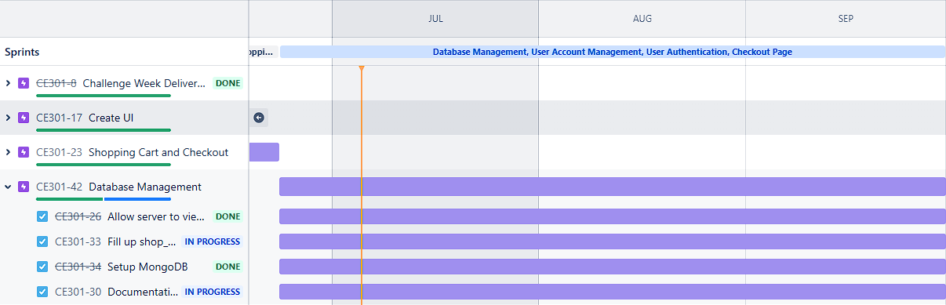
Sprint 4

Slide 36
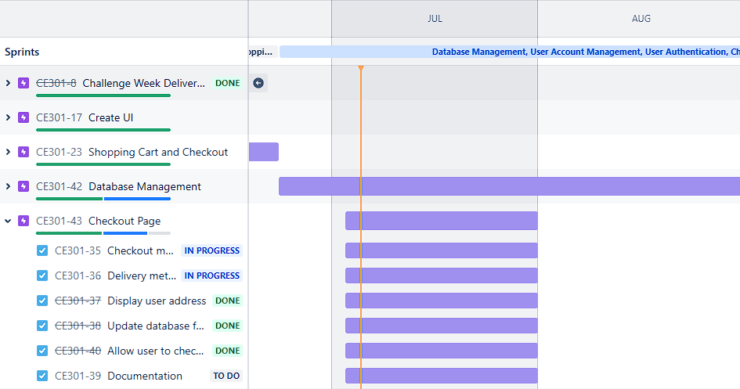
Sprint 5

Slide 37
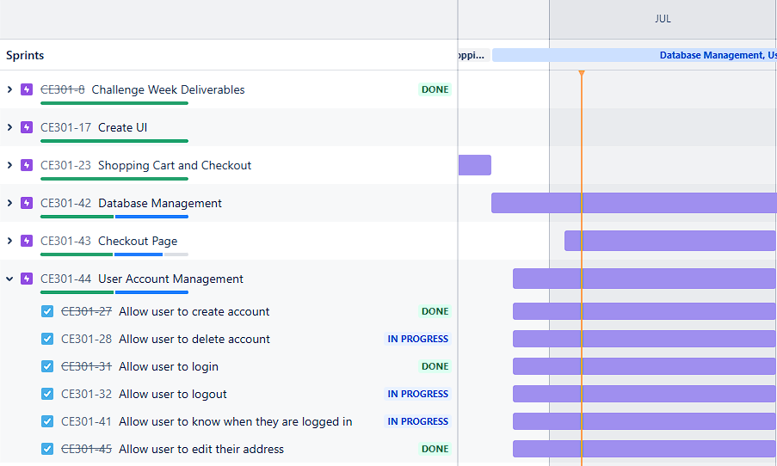
Sprint 6

Slide 38
Thank you

